Slide 1
Example: R&E Supplies
R&E Supplies, Inc. is a wholesaler of plumbing and electrical supplies.
R&E has been a customer of Suburban National Bank for many years.
Average deposits have been $30K.
Short-term renewable loan has been $50K, with a 5-year maturity.

Slide 2
R&E’s Current Situation
In late 2014, R&E asks that the loan amount for 2015 be increased to $500K.
R&E explains that because of growth, AP has gone up and cash balances have gone down.
Suppliers are threatening to go to COD.
Why $500K?
Pro forma financial statements will give better quantitative justification for R&E’s request.

Slide 3
TABLE 3.1 Income Statements for R&E Supplies 2011-2014
What’s happening with R&E’s profitability?

Slide 4
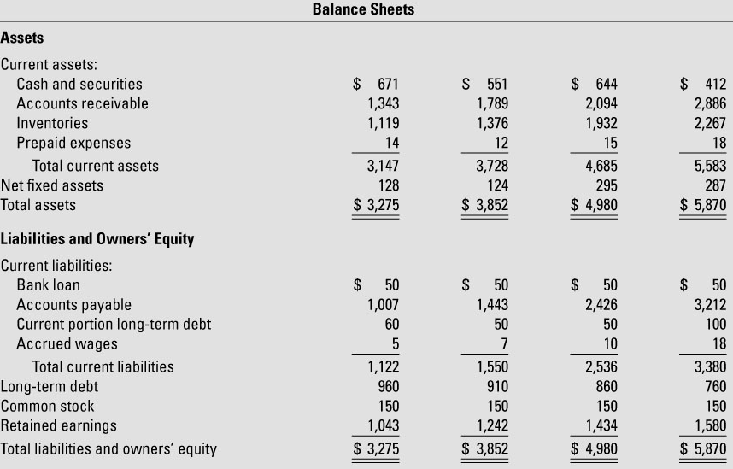
TABLE 3.1 Balance Sheets for R&E Supplies December 31, 2011-2014
Why is cash declining?
Why are AP increasing?

Slide 5
TABLE 3.2 Historical Financial Ratios for R&E Supplies 2011-2014 and 2015 Forecast
Are these forecasts reasonable?

Slide 6
Step 4: Forecast Other Items Not Closely Linked to Sales
Prepaid expenses = rough guess
Net fixed assets?
capital budget of $43K already approved
$50K depreciation
$280K = $287K (prior year) + $43K – $50K
Bank loan initially set to $0, but only temporarily.

Slide 7
Additional Items
Current portion (100) of long-term debt is contractual (760 = 660 + 100)
Note assumption that new loans = 0
Retained earnings?
Prior year RE + income statement earnings – dividends

Slide 8
TABLE 3.3 Pro Forma Income Statement for R&E Supplies, 2015

Slide 9
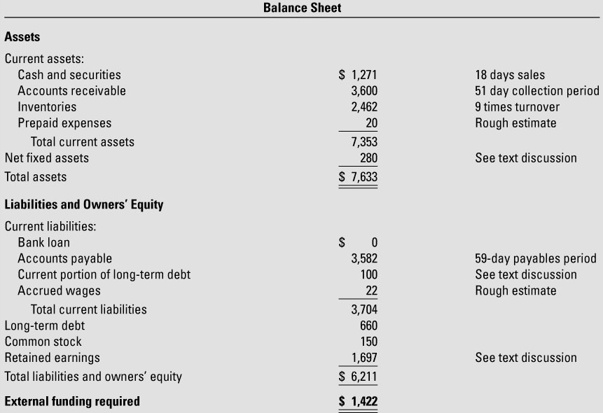
TABLE 3.3 Pro Forma Balance Sheet for R&E Supplies, December 31, 2015

Slide 10
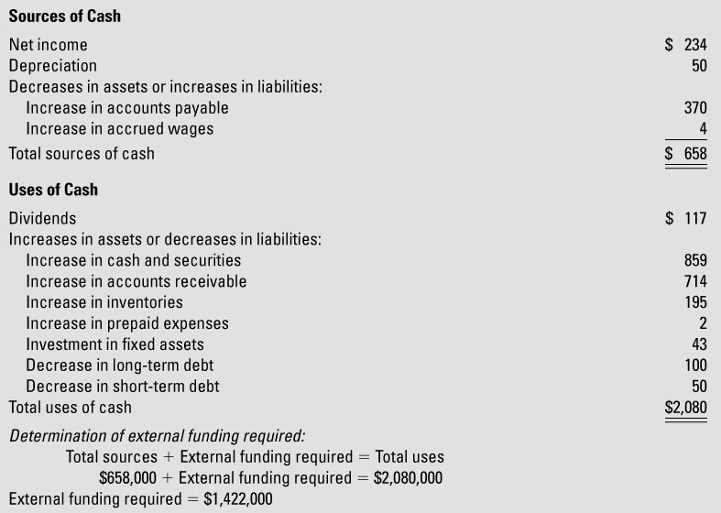
TABLE 3.6 Cash Flow Forecast for R&E Supplies, 2015

Slide 11
Cash Budgets
Pro forma statements rely on accrual accounting.
Cash budgets are strictly cash accounting.
Cash budgets require translation from accrual projections to cash projections.
Adjust for timing of collections and payments.
Example: Jill Clair Fashions’ monthly cash budget
2%/10 net 30 days – factoring it in

Slide 12
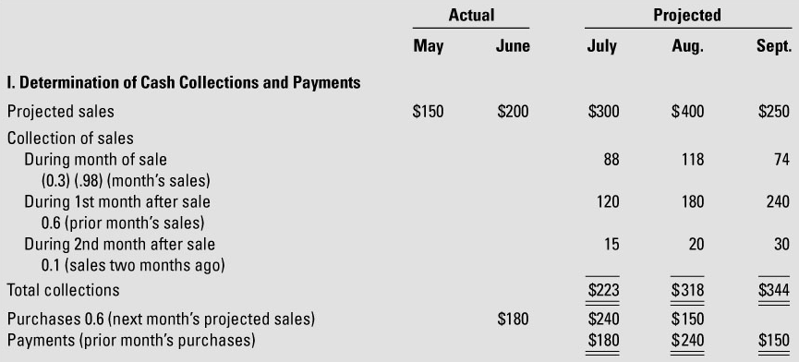
TABLE 3.7 Cash Budget for Jill Clair Fashions 3rd Quarter, 2015

Slide 13
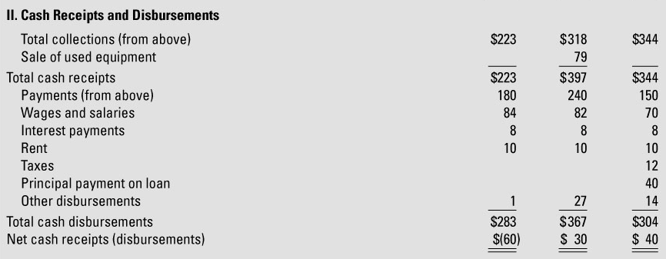
TABLE 3.7 Cash Budget for Jill Clair Fashions 3rd Quarter, 2015

Slide 14
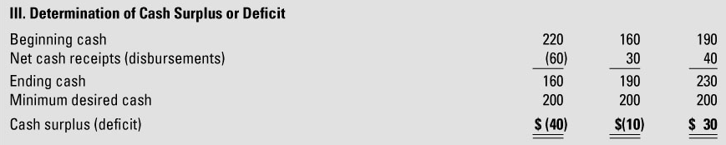
TABLE 3.7 Cash Budget for Jill Clair Fashions, 3rd Quarter, 2015

